Slide 1
How to access eServices
Lyman Field Composite Squadron

Slide 2
First things first
You will need to wait until your membership application is processed.
Once your membership application has been processed, you will receive a welcome email from National Headquarters. You can now, register for your eServices account

Slide 3
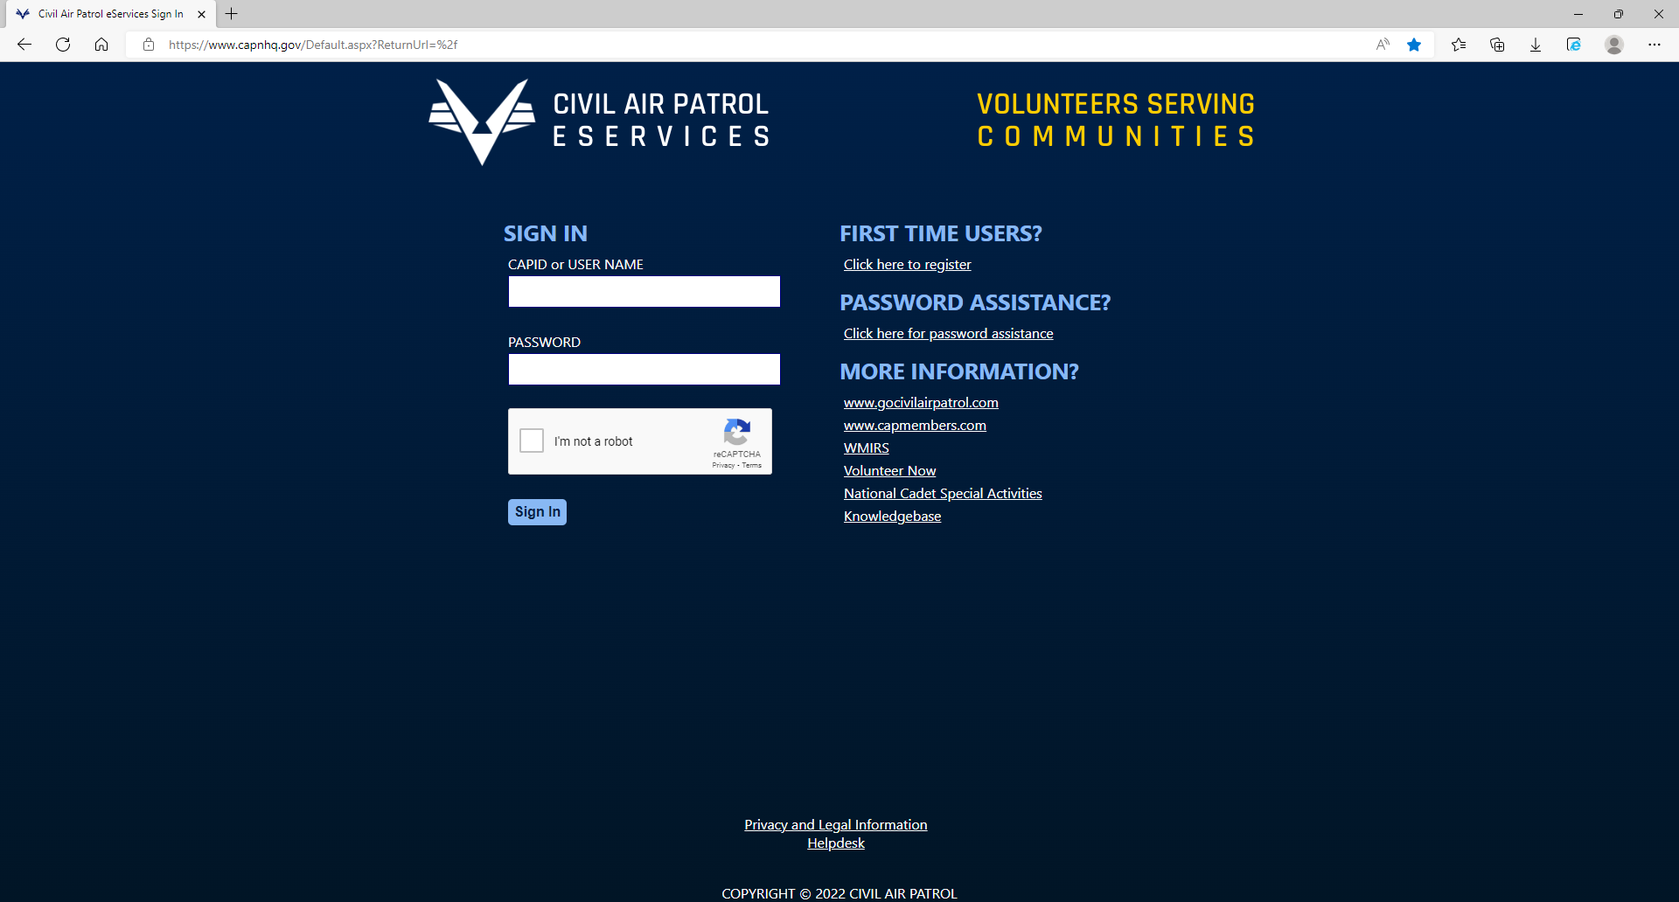
Step One
Go to eServices which is found at capnhq.gov

Slide 4
Step Two
Click on the link located under the "First Time Users" Heading

Slide 5
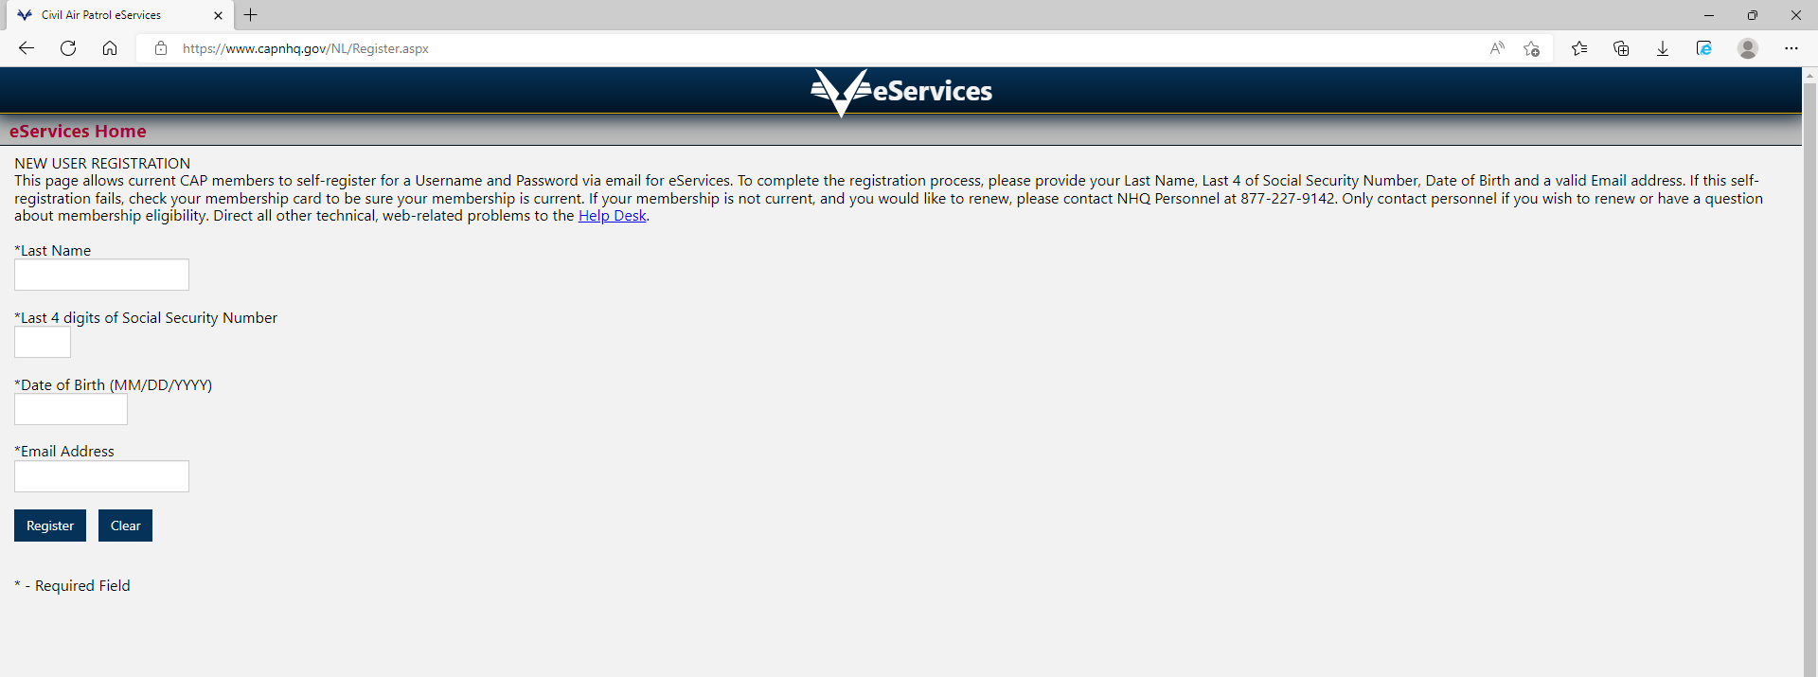
Step Three
Fill it out
Once done, your login information will be sent to the email provided
Follow the instructions on the email to make your password and set your security question

Slide 6
Step Four
Type in your CAPID or Username, your password, and click the "I'm not a robot" box. Then click "sign in".

Slide 7
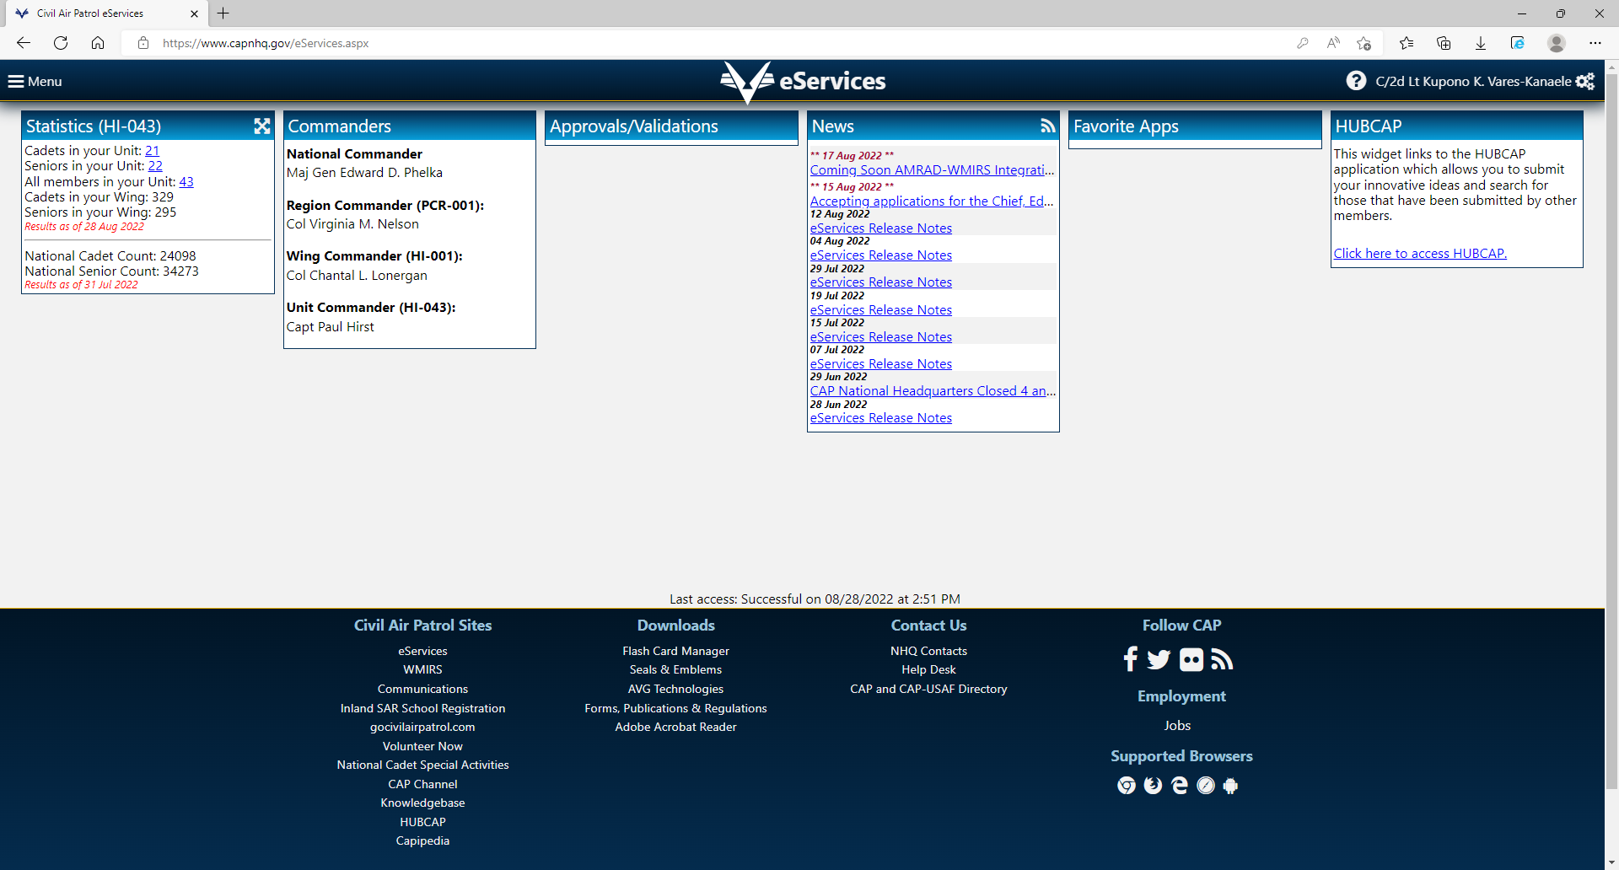
You have successfully logged into eServices!

Slide 8
How to reset your eServices password

Slide 9
Step One
Click on the link under the "Password Assistance" heading

Slide 10
Step Two: Simply follow the instructions on the screen

Slide 11
HOW TO UPDATE CONTACT INFORMATION

Slide 12
Click on your Name

Slide 13
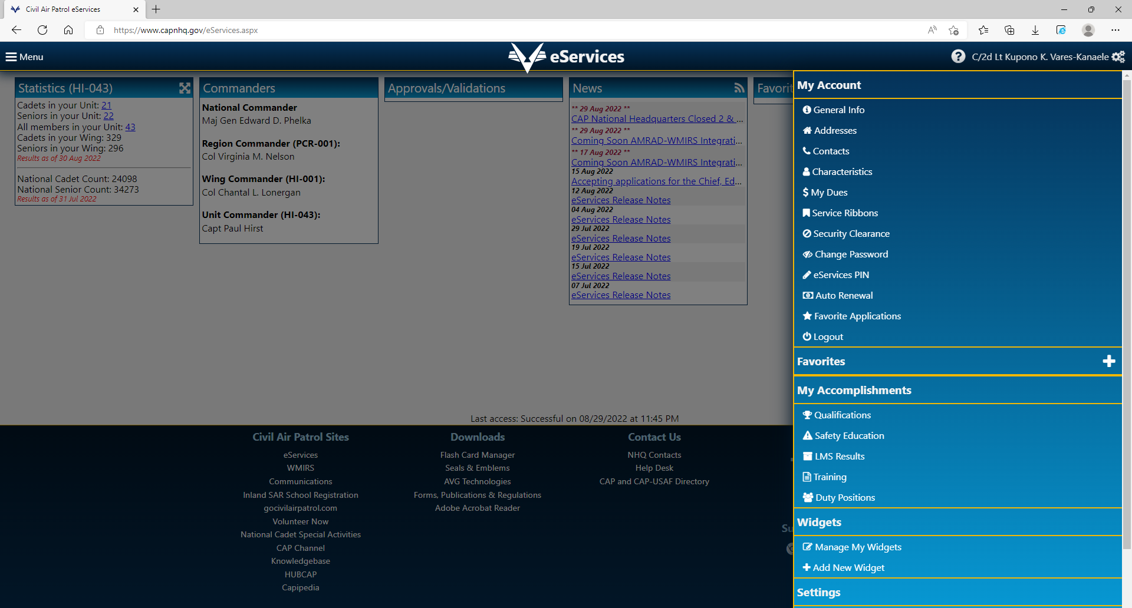
Then click on "Contacts"

Slide 14
Step Two: Update your information by clicking on "edit" (Applies to both email and phone numbers)

Slide 15
If you want to add new contact information, fill out the information under the "Add new contact" header. Then click on save new contact.

Slide 16
Note that if you wish to update the mailing address that is on file, click on "Addresses" and you will be able to update your address.

Slide 17
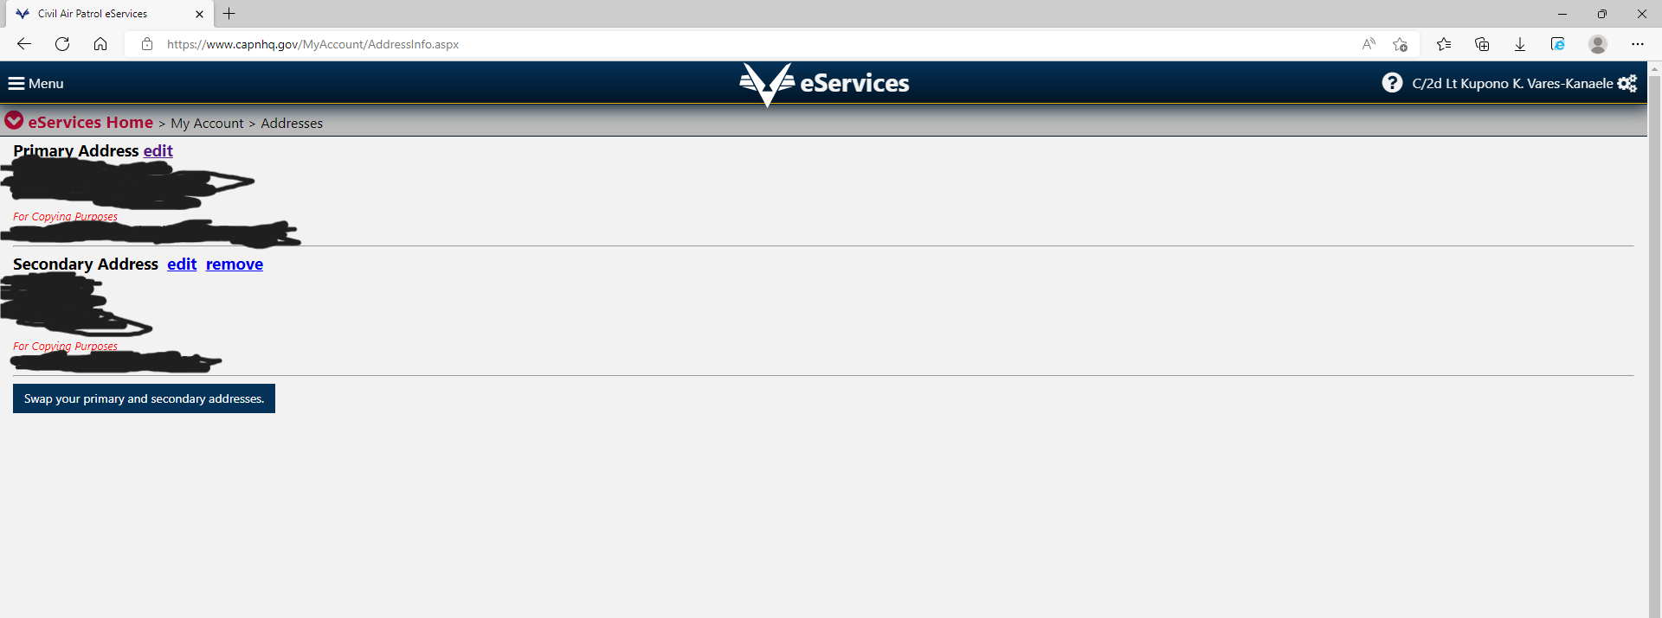
Note that you can add a secondary address as well. Secondary addresses can also be removed.

Slide 18
THANK YOU! SEMPER VIGILANS!

