Slide 1
How to access Cadet Testing Modules
Lyman Field Composite Squadron

Slide 2
The purpose of this presentation
We want to make sure that you know how to access Cadet testing modules so that you can start promoting ASAP
We will go step by step so that you will have a clear picture on what you will need to do.

Slide 3
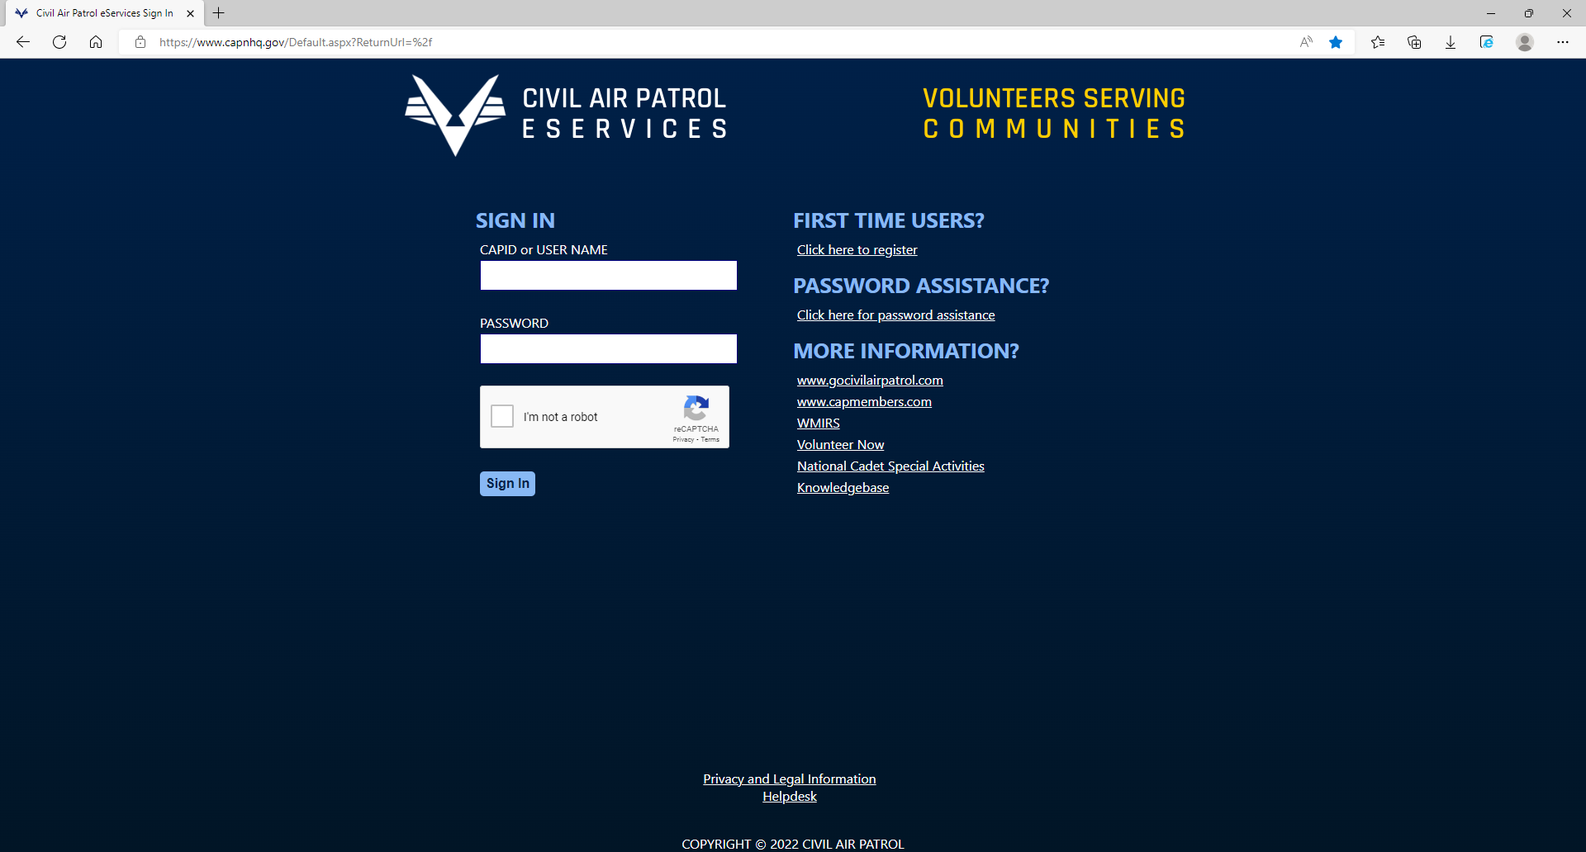
Step One
Go to eServices which is found at capnhq.gov and login

Slide 4
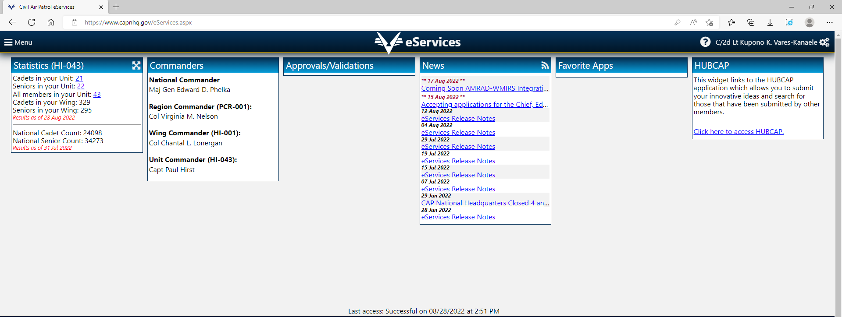
Step Two: Click on Menu

Slide 5
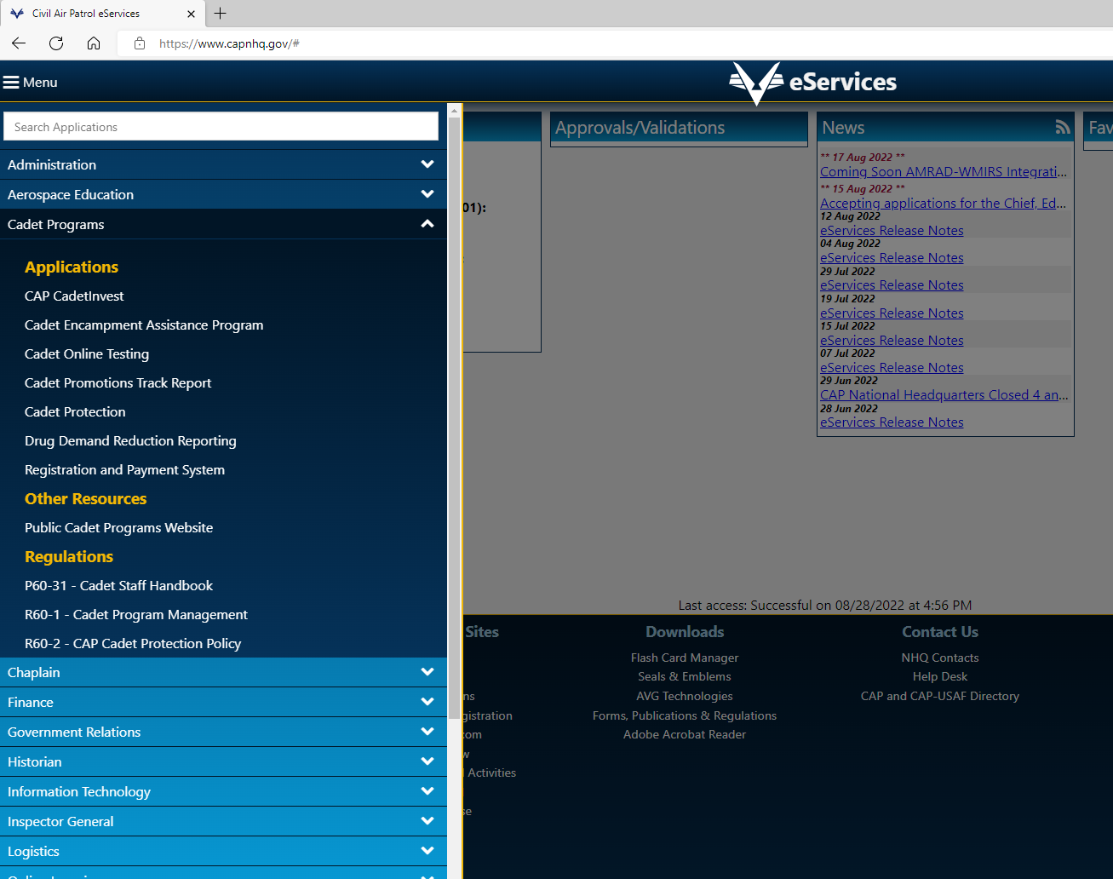
Then click on Cadet programs and select "Cadet Online Testing"

Slide 6
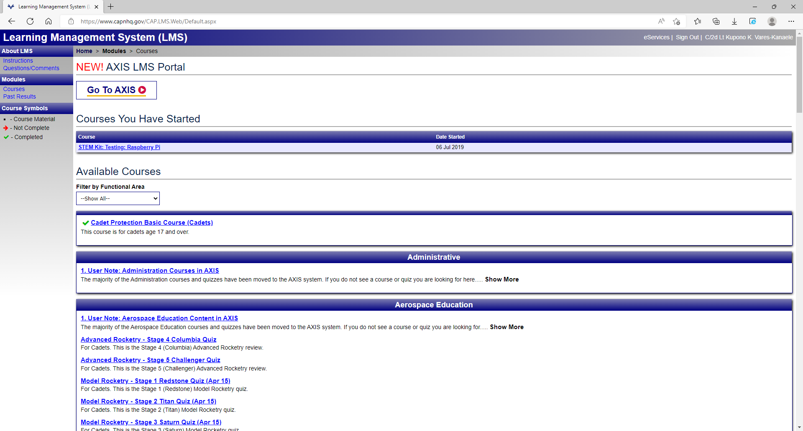
Step Three: Click on "Go to AXIS"

Slide 7
Step Four: Click on "Cadet Achievement"

Slide 8
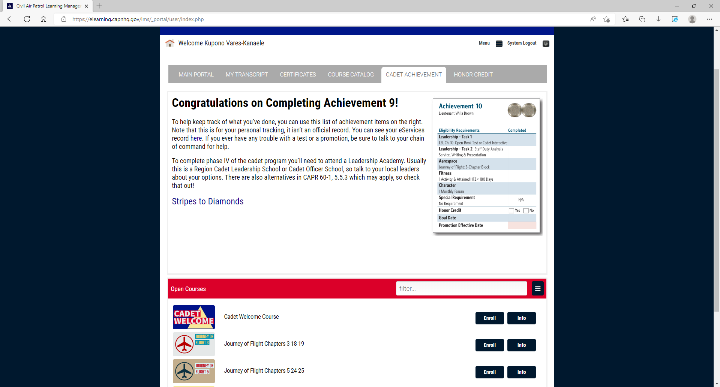
Step Five
Scroll down and you will find your required test. Once you find the test you want to take click on "Enroll" and you will be able to open the test
If you need to take your test another time, you can find in the "main portal" section under "Courses in progress"

Slide 9
ANY QUESTIONS?

Slide 10
THANK YOU! SEMPER VIGILANS!

